Slide 1
BD JOB HUNTER
Online Job Portal

Slide 2
CSE 3412 Project Show SPRING 2022 MD. RAFI-UR-RASHID LECTURER, DEPT. OF CSE, UIU

Slide 3
Group Members: Tamal Kumar Sarker, ID: 011181054 Md Mohiuddin Munna, ID: 011173035 Ashikur Rahman Likhon, ID: 011191098 Khondokar Mahmudur Rahman, ID: 011173037 Shahriar Shifat, ID: 011181168

Slide 4
Consistency

Slide 5
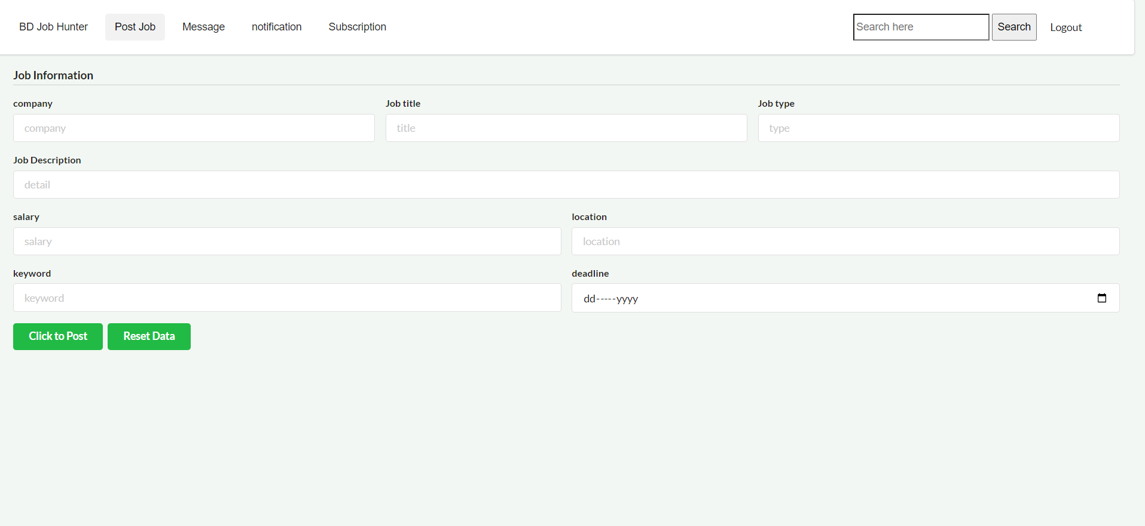
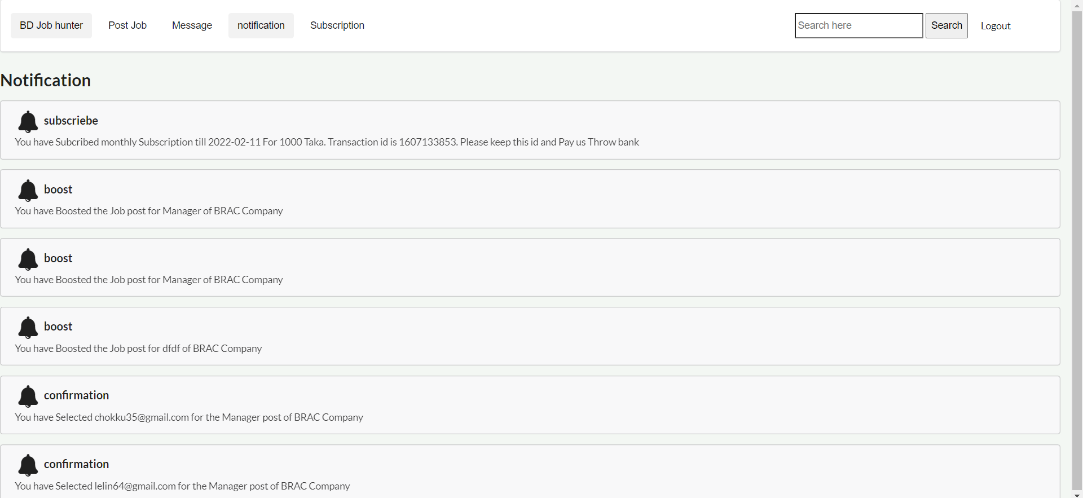
Here all the pages have same design, same navigations bar so it maintains Consistency

Slide 6
Mapping

Slide 7
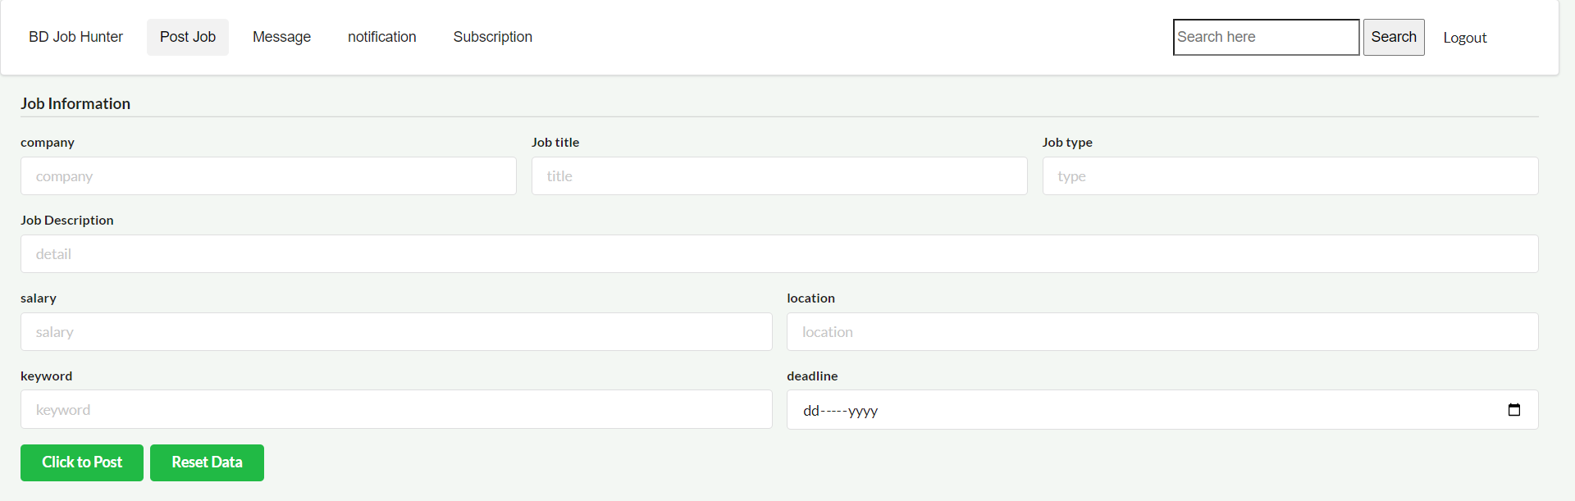
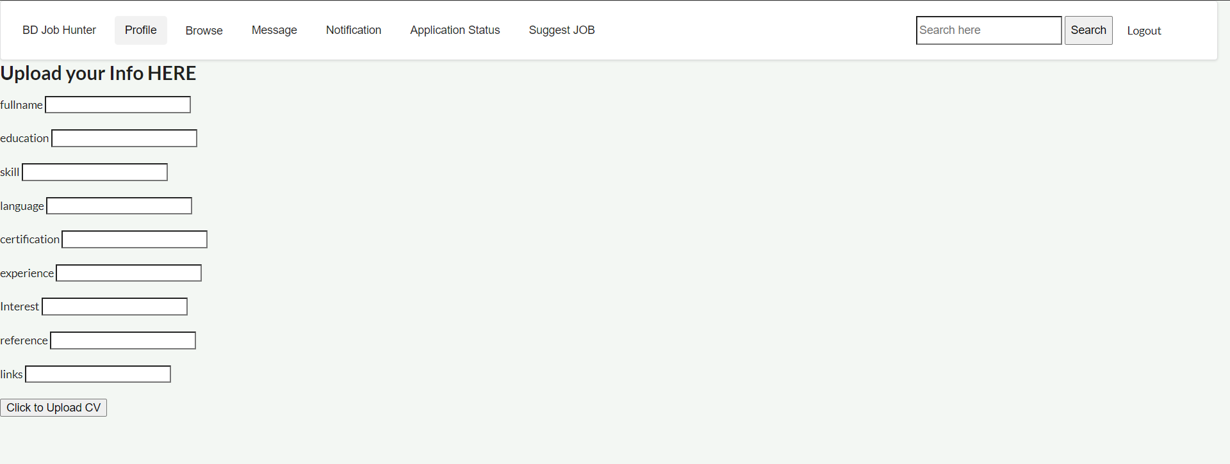
In here we have used familiar language. We just use keyword of all the blanks.

Slide 8
Recognitions

Slide 9
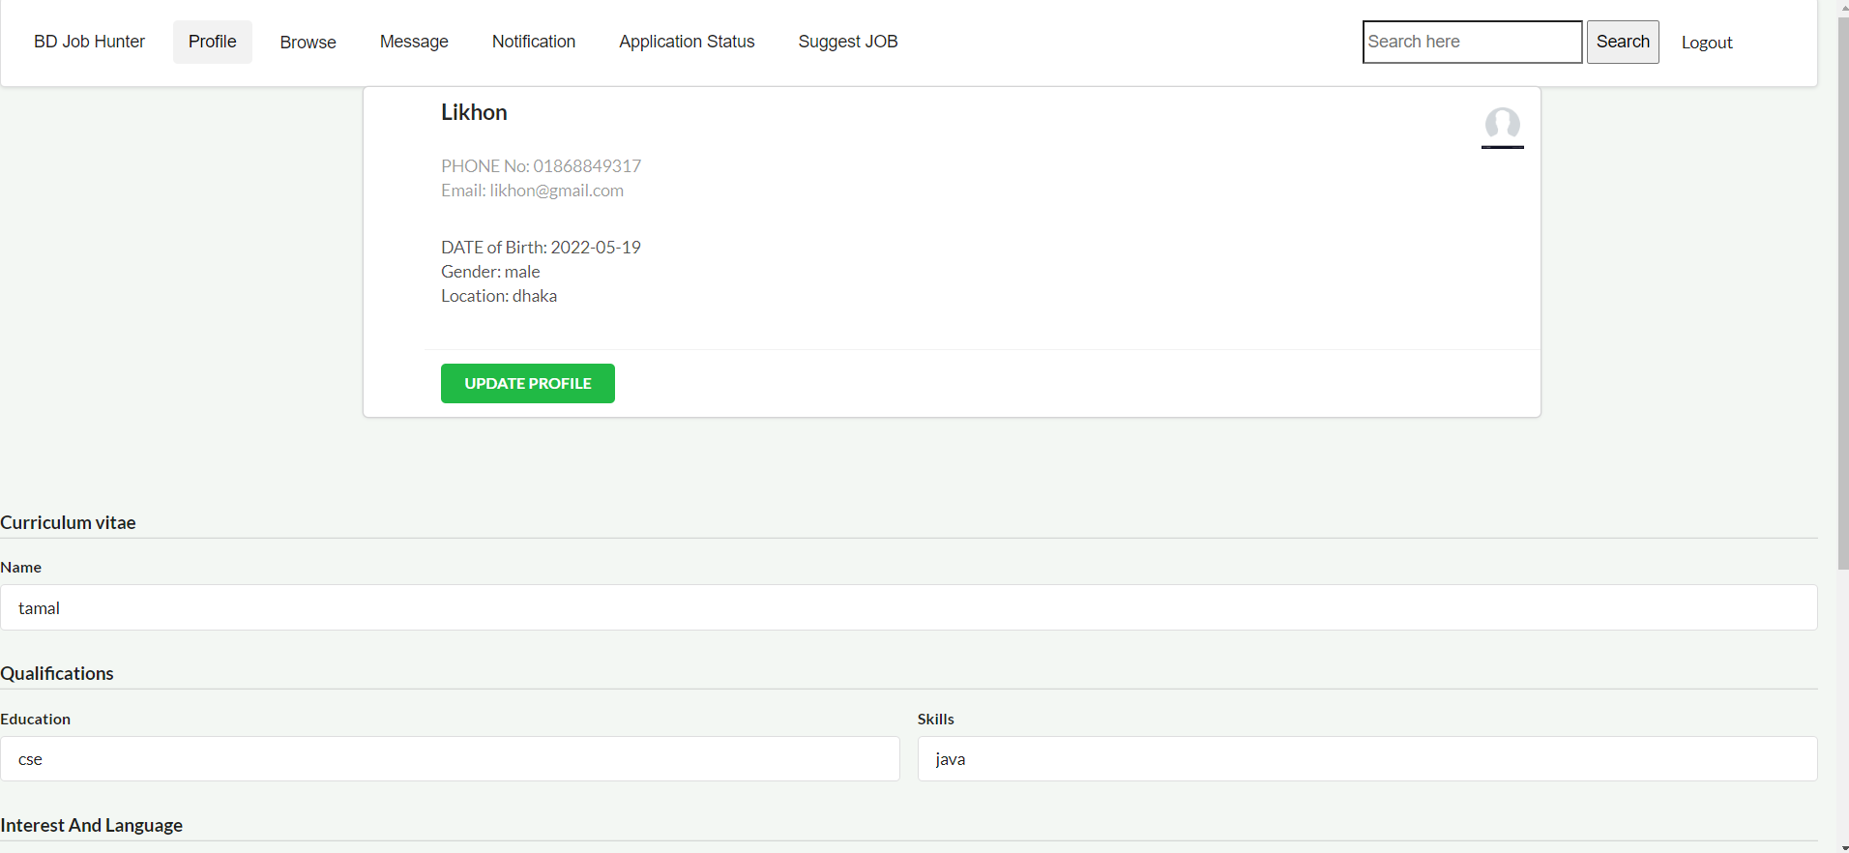
Here all the features we can find easily. In navigation bar we included the features which we can find easily and quickly.

Slide 10
Minimalism

Slide 11
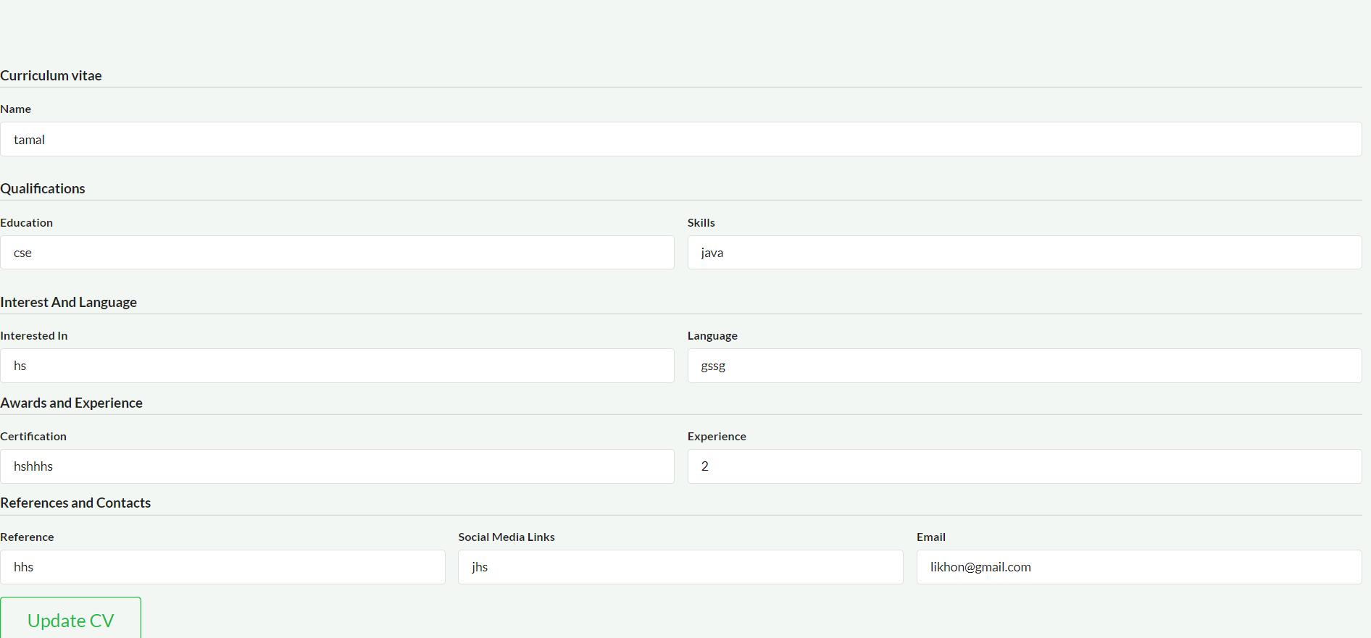
Here we didn’t include extra info. We just told what the blank means. User can easily understand what it means.

Slide 12
Thank You

